Slide 1
E343: Week 9
READINGS FOR TODAY:
Van de Walle et al. Addition and Subtraction
Notes:
Welcome students and set the stage for the session. Today we're exploring addition problem structures - a foundational concept for understanding how children learn basic facts and for ensuring equitable math instruction. Reading: Van de Walle et al., pp. 159-171 (ed. 11) on addition and subtraction problem structures.

Slide 2
Agenda
Finish Math Process Standards, Gallery Walk (15 minutes)
Discuss Addition and Subtraction Problem Types (20 minutes)
Write Different Problem Types (30 minutes)
Summary: What matters for teaching? (10 minutes)
Notes:
Quick review of agenda. First, we'll finish up the Math Process Standards work with a gallery walk (15-20 min). Then transition to the main topic: discussing the four addition problem types - Join, Separate, Compare, and Part-Part-Whole. Students will fill out a handout identifying problem types (Part A), varying unknown parts (Part B), and comparing types. Expect this segment to take about 30-35 minutes. Later, students will rotate through station activity to write and solve problems of each type.

Slide 3
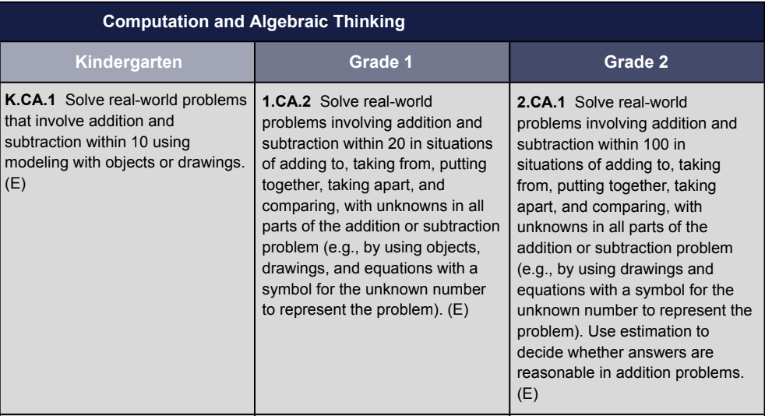
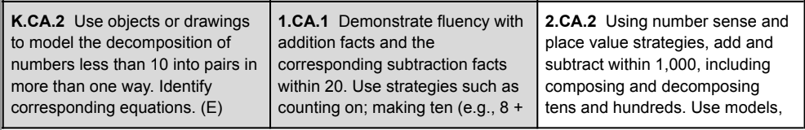
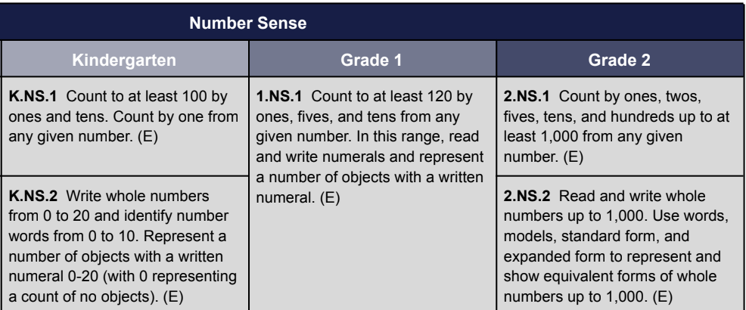
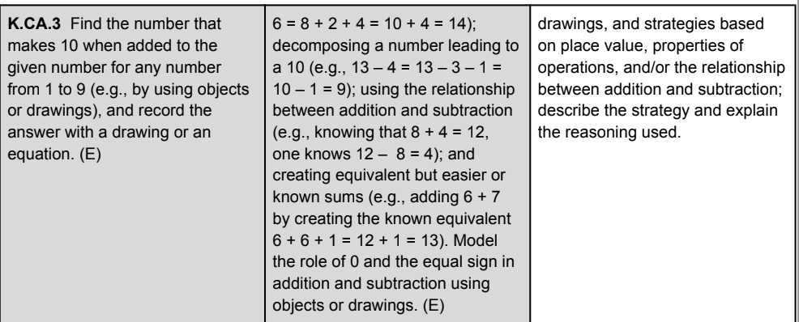
Where are we in Standards?
Notes:
Context: We're in the K-2 computation and algebraic thinking block. Emphasize the connection between problem types and algebraic thinking - different unknown positions in a problem structure represent different algebraic thinking opportunities. This is part of a larger arc toward understanding fact fluency.

Slide 4
Why do we Care About Problem Types?
Helps you ensure that all problem types are addressed in instruction
Some curricula focus on only some problem types instead of all of them – puts students at a disadvantage for future math (and standardized tests, shhhhh)
Sharing problem types with students--pros:
Can help students who are having trouble deciding what to do learn how – if they can classify a problem, they can solve it (this is a SPED technique that helps everyone)
Makes explicit some of the implicit parts of word problems
Some curricula do this (CMP3, for example, which is used in 6th grade at MCCSC)
Sharing problem types with students--cons:
Adds an extra layer of complexity for students who don’t need it
It’s unlikely that future teachers will refer to problems in this way
It’s tempting to test students on problem type identification – DON’T do that!
Notes:
Critical instructional point: Not all curricula address all problem types equally. Some focus heavily on Join problems, leaving gaps that disadvantage students on standardized tests and in future mathematics. Using contextualized problems that vary in structure ensures all students develop flexible thinking. Highlight that understanding WHY we vary problem types improves your instructional choices.

Slide 5
Four Types of Problems
Join (Action)
Example: Karly had 5 pennies. Her sister gave her 8 more. How many pennies does she have now?
Separate (Action)
Example: Carrie had 17 rocks in her rock collection. She gave 9 to her best friend. How many rocks does she have now?
Part-Part Whole (No action)
Example: Madison has 8 apples. She has 5 bananas. How much fruit does she have?
Compare (Comparison)
Example: Cate has 8 apples. She has 5 bananas. How many more apples does she have than bananas? OR How many fewer bananas does she have than apples?
Practice time! Go to p. 6 of the Unit 3 Packet
Notes:
This is your main teaching slide. Go through the four problem types carefully: - JOIN (Action): Something is added to a starting amount. Example: "Maria had 4 apples. Her friend gave her 3 more. How many does she have now?" - SEPARATE (Action): Something is taken away. Example: "Maria had 7 apples. She ate 2. How many are left?" - COMPARE (No action): Two amounts are compared. "Maria has 4 apples. John has 7. How many more does John have?" OR "How many fewer does Maria have?" - PART-PART-WHOLE (No action): Two parts combine to make a whole. Example: "There are 4 blue blocks and 6 red blocks. How many blocks altogether?"
Key distinction: Join/Separate have ACTION words (gave, ate, bought, lost, etc.). Compare and Part-Part-Whole do NOT have action. Children often find action problems easier initially. STOP and have students complete Part A of the handout - identifying which type each problem is.

Slide 6
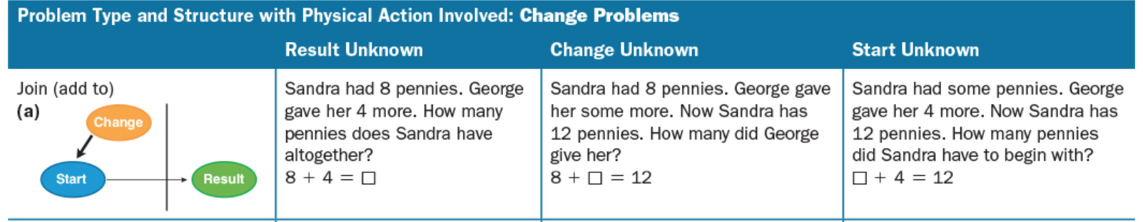
Different Parts of a Problem Can be Unknown
Practice time! Go to p. 6-7 of Unit 3 handout.
Notes:
Critical insight: For ANY problem type, different parts can be unknown. Show the three variations for Join: - Result Unknown (easiest): "Maria had 4. Got 3 more. How many now?" (4 + 3 = ?) - Change Unknown (harder): "Maria had 4. Someone gave her some. Now she has 7. How many did she get?" (4 + ? = 7) - Start Unknown (hardest): "Maria had some. Got 3 more. Now has 7. How many did she start with?" (? + 3 = 7)
These correspond to different algebraic thinking - the unknown position changes the equation form. This is foundational for later algebraic reasoning. Have students work through Part B - writing problems with different missing parts for their assigned problem type.

Slide 7
Get Into Small Groups
For your problem type, write three problems, one for each part that could be missing.
Write
Notes:
Transition to small group work. Divide class into 8 groups (or adapt to class size). Assign each group one problem type and one unknown variation. For example: "Group 1, you have Join-Start Unknown." Each group writes 3-5 problems of their assigned type with the specified missing part. Problems should be accessible to 1st/2nd graders and clearly contextualized. Circulate to ensure groups understand the task. This is hands-on application of problem structure knowledge.

Slide 8
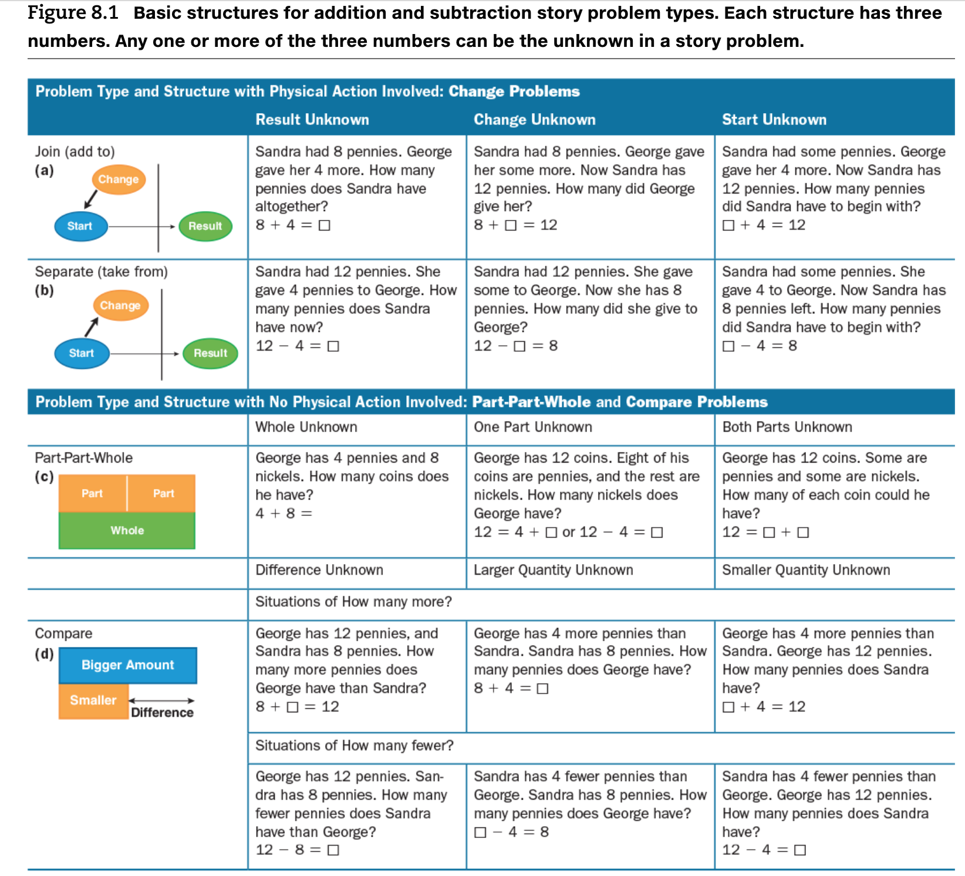
Figure 8.2 VdW, pp. 161-162
Notes:
This is Figure 8.2 from Van de Walle (pp. 161-162, ed. 11). This comprehensive table shows all 12 problem structures (4 types x 3 unknown positions). Use this to show students how problem structures organize. Point out that: - Join and Separate are similar in structure but opposite in action - Compare has unique features (comparing two amounts; "more" vs. "fewer") - Part-Part-Whole is about composition, not action Students should see this table as a systematic way to think about problem variety in curriculum.

Slide 9
Activity Instructions
Groups of 3 go to one of the pieces of paper posted around the room (there are 8 total piece of paper).
Write a word problem with that problem type and the unknown part. Your instructor will give you what part is unknown (e.g., join change unknown).
Switch stations, solve the problem that the previous group wrote, and write a new problem on the piece of paper for the next group.
Rotate through until you have been to all 8 stations.
Notes:
Now execute the station rotation activity. 8 sheets posted around room (or adapt to group count). Each sheet is labeled with a problem type and unknown variation (e.g., "Separate-Change Unknown"). Groups rotate through rounds. In each round: 1) Read the problem type/variation at the station 2) Write 1-2 word problems of that type 3) Move to next station when time is called This builds fluency in generating varied problems and recognizes that each structure type has multiple forms. Timing: 3-4 minute rotations work well. Call out transitions clearly. Emphasize quality over quantity.

Slide 10
Rounds
Round | Join & Separate Posters | Part-Part-Whole Posters | Compare Posters
Round 1 | Result Unknown | Whole Unknown | Difference Unknown
Round 2 | Change Unknown | Part Unknown | Compared Quantity Unknown
Round 3 | Start Unknown | Part Unknown (Repeat) | Referent Unknown
Round 4 | Free Choice | Free Choice | Free Choice
Notes:
This table shows the rotation schedule. Likely structure: Join and Separate posters (action problems) are in one area; Compare and Part-Part-Whole (static problems) in another. You may have 2 of each type with different unknown variations. Manage transitions firmly. Collect sheets at end to see student understanding and use as formative assessment. Note which types students struggle with - this tells you where to focus future instruction.

Slide 11
Summary: What Matters for Teaching?
Story Problems and Context Problems
Planning for multiple ways to represent thinking
Offering a variety of problem types
Considering different number choices (e.g., some students might work with the numbers 8, 4, and 12; others might be ready to work with the numbers 42, 30, and 72; and still others might be ready to work with the numbers 28, 37, and 65)
Notes:
Synthesis discussion - bring everyone back together. Three key takeaways: 1. STORY PROBLEMS & CONTEXT MATTER: Real-world context helps children understand what operation to use. Not all context problems are created equal - they must vary in structure type. 2. MULTIPLE REPRESENTATIONS: Show the same problem type represented in different ways (drawings, number lines, equations, arrays). This helps children who don't yet have access to standard written notation. 3. PLANNING FOR DIVERSITY: When you understand problem structures, you can intentionally include all types in your curriculum, ensuring all students develop flexible thinking, not just those who naturally gravitate to action problems.
Wrap up with: "Next time, we look at how problem structures connect to basic fact knowledge and automaticity."

Slide 12
Until We Meet Again
Lesson 1 revised version due tonight – have fun teaching tomorrow!!!!!!
Week 9 Check-In, due Thu.
Lesson 1 transcripts due Sun.
Van de Walle et al. reading
Reminder: If you are teaching this week, have someone video record your lesson so you can do the Lesson Analysis assignment!
Notes:
Closing slide. Reinforce key deadlines: - Lesson 1 revised version due TONIGHT (students are teaching tomorrow!) - Week 9 Check-In due Thursday Celebrate their work and preparation. This is a practical course - they need these problem structures TOMORROW in their classrooms. Send them off with confidence and enthusiasm. Offer office hours if anyone needs help with the revised lesson.

